Slide 1
Applying Deep Learning Techniques – Gesture Recognition to enable intuitive interaction with Smart Televisions
KEVIN PAUL
10387149

Slide 2
BUSINESS PROBLEM
The hand gesture recognition system solves a business problem for the home electronics company by making the user experience better and increasing the market value of smart TVs.
By adding a cool feature that lets users control the TV with hand gestures instead of a traditional remote control.
The traditional remote control has problems in terms of how easy it is to use, how easy it is to get to, and how easy it is to lose or break.
By adding hand motion recognition, the company can give users an easy-to-use alternative way to control the device

Slide 3
RESEARCH PROBLEM
Traditional smart television interaction methods primarily concentrate upon remote controls, with some modern upgrades such as voice commands and limited touchscreen functionality.
Remote controls: Despite their widespread use, they frequently suffer from challenges like as misplacement, battery dependency, and wear-and-tear.
voice-controlled functions appear futuristic, they sometimes suffer from mistakes caused by ambient noise and regional accents.
Touchscreen: Touch technology, which is only found in a few high-end models, is incompatible with wall-mounted TVs and lacks the ease of long-distance interaction.

Slide 4
RESEARCH AIM
The primary goal of this study is to design, develop, and validate a comprehensive deep learning framework that enables smart televisions to detect and interpret five distinct hand gestures in real time.
Thumbs up : Increase the volume.
Thumbs down : Decrease the volume.
Left swipe : 'Jump' backwards 10 seconds.
Right swipe : 'Jump' forward 10 seconds.
Stop : Pause the movie.

Slide 5
RESEARCH QUESTION
How can a robust and efficient algorithm be designed to detect and classify five distinct hand gestures in real-time video input?

Slide 6
DATA UNDERSTANDING
The dataset is obtained from the Kaggle website, Kaggle is a well-known platform in the data science community, providing an abundance of datasets, machine learning competitions, and educational materials.
The data consists of a 'train' folder and a 'val' folder, each containing two CSV files.
These folders are further subdivided into subfolders, with each subfolder containing a video of a specific gesture.
Each video subfolder comprises 30 frames (or images).

Slide 7
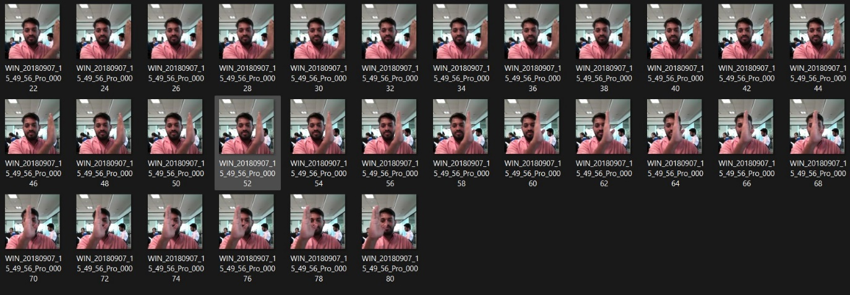
Example of 30 frames inside a subfolder

Slide 8
Gesture Recognition Techniques
Two models have selected, one is the CNN architecture and other is CNN plus RNN architecture which is applied to the prepared data.
Given the nature of our problem, deep learning models such as Convolutional Neural Networks (CNNs), which are well-suited for image and sequence data, respectively.
The combination of convolutional neural networks (CNNs) and recurrent neural networks (RNNs) has emerged as a potent tool for video classification tasks in recent years

Slide 9
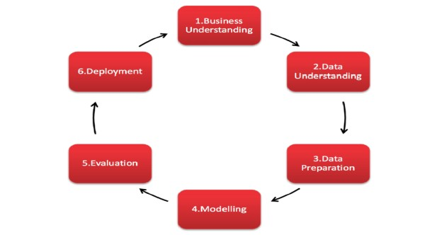
RSEARCH METHODOLOGY

Slide 10
RESULT
After creation of two models, the next step is to plot training & validation accuracy values. The figure below represents the code to plot training & validation accuracy values.
Next step is to evaluate the final model performance on the validation data.
The accuracy of the first model's categorical predictions was 83%, with a validation loss of 0.4115. The validation loss of the second model was 0.9574, and its categorical accuracy was 63%.
A comparison of the models implemented for this project, namely, CNN model and CNN plus RNN model is shown below

Slide 11
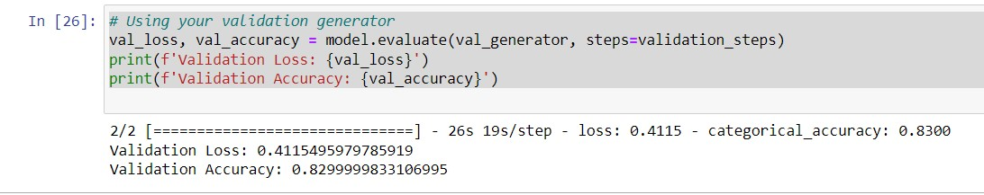
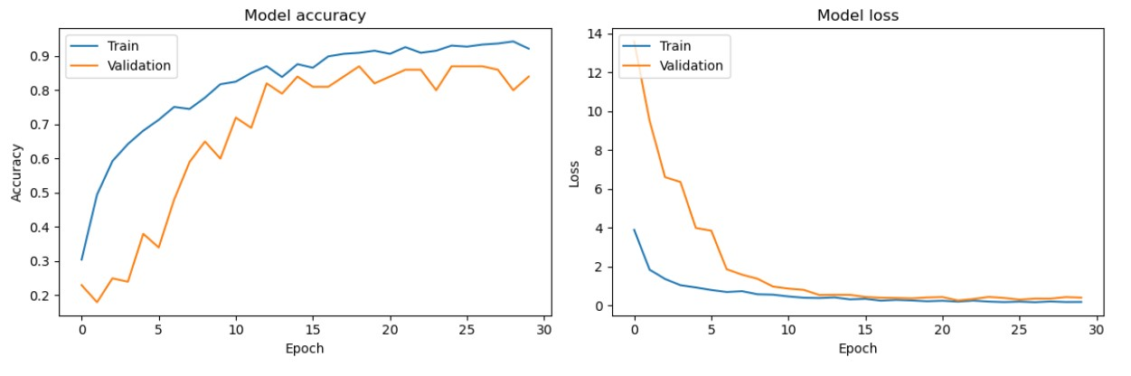
MODEL 1: CNN

Slide 12
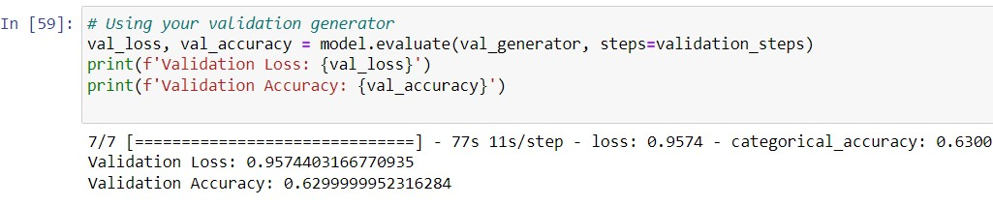
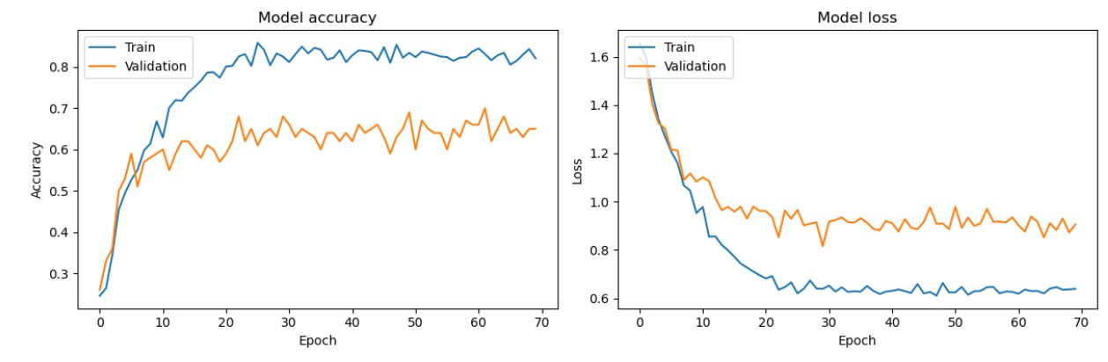
MODL 2 : CNN+RNN

Slide 13
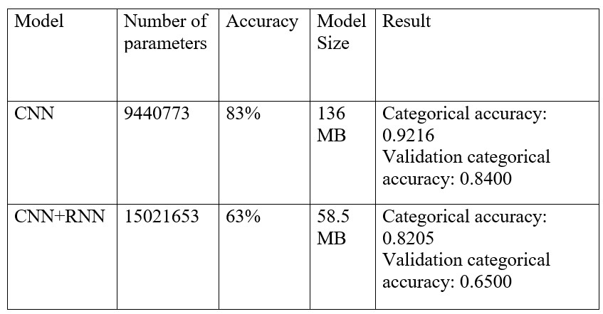
Comparison of the different models implemented

Slide 14
Conclusion
A comparison of the models implemented for this project, namely, CNN model and CNN plus RNN model is shown in Table below.
From the result, the best model achieved is the first model that is the CNN model as it has 83% of accuracy as compared to the second model, its accuracy is only 63%.
For further procedures, model 1 will be selected.

Slide 15
Thank You

